Slide 1


Organizational Behavior
(MGT-502)
Lecture-20

Slide 2
Summary of
Lecture-19

Slide 3

Group Problem Solving Techniques
Consensus presenting opinions and gaining agreement to support a decision
Brainstorming process to generate a quantity of ideas
Nominal Group Technique process to generate ideas and evaluate solutions
Delphi Technique process to generate ideas from physically dispersed experts
Computer-Aided Decision Making

Slide 4
Decision making model
1. Identify
problem
6. Evaluate
decision
2. Choose
decision
style
5. Implement
solution
3. Develop
alternatives
4. Choose
best solution

Slide 5
How involvement improves decisions
Leads to better definition of problems
Employee
involvement
Improves number and quality of solutions
More likely to select
the best option

Slide 6
Other Consequences of Group Decision Making
Diffusion of Responsibility
Group Polarization
Potential for Conflict

Slide 7


Organizations Can Facilitate Creative Decision Making
Reward creativity
Allow employees to fail
Make work more fun
Provide creativity training
Vary work groups (internal/external)
Encourage creative stimuli (music, art, etc.)

Slide 8

Ethics Check
Is it legal?
  Does it violate law
  Does it violate
  company policy
Is it balanced?
  Is it fair to all
  Does it promote win-win relationships
How will it make me feel about myself

Slide 9
Today’s Topics

Slide 10
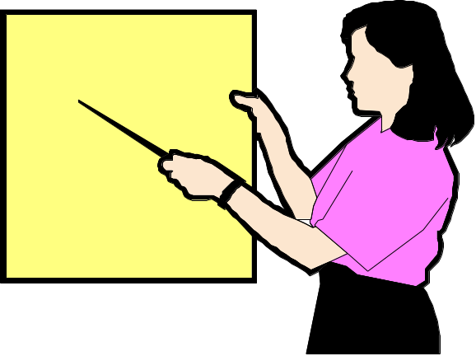
Communication Defined
The transmission of information and understanding through the use of common symbols.

Slide 11
The Importance of Communication Skills
“Top executives from Fortune 500 companies rate communications skills as the most important quality for business leaders.”
New York Times
Business Section
“There may be no single thing more important in our efforts to achieve meaningful work and fulfilling relationships than to learn and practice the art of communication.”
The Art of Leadership
Max De Pree, Author

Slide 12
The Communication Process
Encoding
Channel
Decoding
Message
Message
Source
Receiver
Feedback

Slide 13


Encoder
Participants

Slide 14

Sending Channel
Encoder
Decoder
Meaning
Encoder
Participants

Slide 15

Sending Channel
Encoder
Decoder
Meaning
Meaning
Decoder
Encoder
Participants
Feedback Channel

Slide 16
Context
Context
Sending Channel
Noise
Encoder
Decoder
Noise
Meaning
Meaning
Decoder
Encoder
Participants
Feedback Channel
Context
Context

Slide 17
The Communication Process
Noise
Decodes
Decodes
Message
Sender
Receiver
Encodes
Encodes
Feedback
Notes:
3

Slide 18
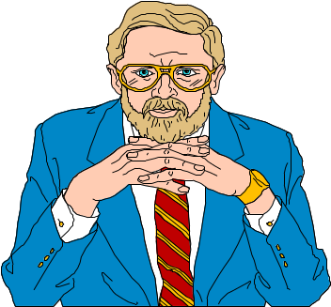
Noise
  Interference in the flow of a message from a sender to a receiver.
Nonverbal Communication
  Messages sent with body posture, facial expressions, and head and eye movements.

Slide 19
Nonverbal Communication
Body Motions
Body Language
Facial Expressions
Tone of Voice
Paralinguistics
Pacing and Pitch

Slide 20
Territorial Space
Territorial Space - bands of space extending outward from the body; territorial space differs from culture to culture
a = intimate <1.5’
b = personal 1.5-4’
c = social 4-12’
a
b
c
d = public >12’
d
Notes:
19

Slide 21
Seating Dynamics
Seating Dynamics - seating people in certain positions according to the person’s purpose in communication
X O
X
O
Cooperation
Communication
X
O X O
Non-
Communication
Competition
O
Notes:
20

Slide 22
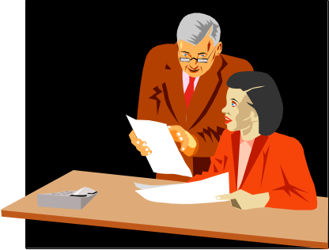
How Communication Works
Communications experts tell us that effective communication is the result of a common understanding between the communicator and the receiver. In fact the word communication is derived from the Latin communis, meaning “common.”

Slide 23
Barriers to Effective Communication

Slide 24
Barriers to Effective Communication
Filtering
  refers to a sender manipulating information so that it will be seen more favorably by the receiver.
Selective Perception
  Receivers in the communication process selectively see and hear based on their needs, motivations, experience, background, and other personal characteristics.
Defensiveness
  When individuals interpret another’s message as threatening, they often respond in ways that retard effective communication.
Language
  Words mean different things to different people.

Slide 25
Cross Cultural Barriers To Communications Include
Time
Location
Space, other body language
Touch
Eye contact
Notes:
17

Slide 26
Barriers to Communication
Physical separation
Status differences
Gender differences
Cultural diversity
Language
Communication Barriers -
factors that block or significantly distort successful communication
Notes:
12
23
23

Slide 27
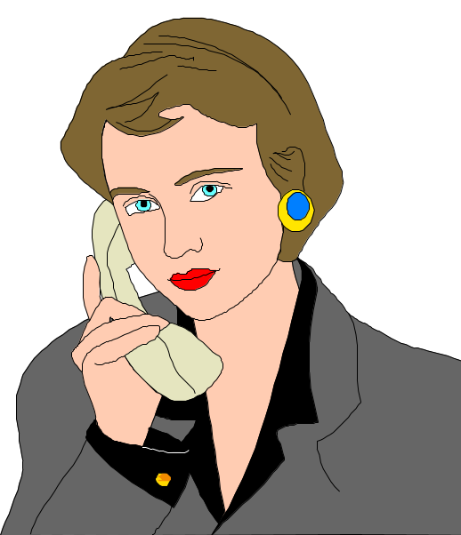
Frame of Reference
Selective Listening
Value Judgments
Source Creditability
Filtering

Slide 28
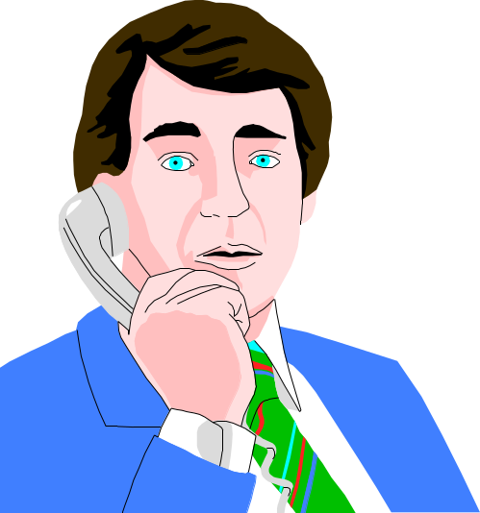
Status Differences
In-Group Language
Time Pressures
Communication Overload

Slide 29


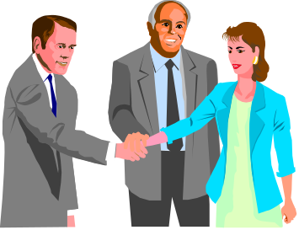
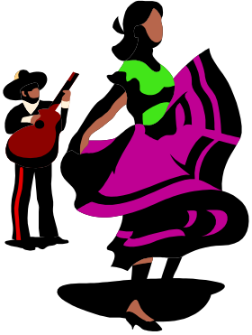
Message Influences
Age
Factors that
influence
sent & received
messages
Gender
Culture
Notes:
5

Slide 30
Overcoming Communication Barriers
Repetition of messages
Use of multiple channels
Simplified language
Feedback

Slide 31
Formal vs. Informal Communication
Formal communication refers to messages that use formally established channels. Follows the chain of authority and command.
Informal communication is more spontaneous communication occurring without regard for the formal channels of communication. (The ‘grapevine’)

Slide 32
Department
Manager
Supervisor
Supervisor

Slide 33
Directions of Communications

Slide 34
Downward Communication
Upward Communication
Communication that flows from individuals in higher levels of the organization’s hierarchy to those in lower levels.
Communication that flows from individuals at lower levels of the organizational structure to those at higher levels.

Slide 35
Horizontal Communication
Diagonal Communication
Communication that flows across functions in an organization.
Communication that cuts across functions and levels in an organization.

Slide 36
The Communication Process
Context
Participants
Messages
Channels
Noise
Feedback

Slide 37
Context – the Setting
Physical – where communication takes place, the environment, the distance between participants, seating, time of day
Social – the nature of the relationship
Historical – the background of previous communication
Psychological – the moods and feelings
Cultural – the set of beliefs, values, and norms that are shared by a large group of people

Slide 38
Participants
Sender
  Form messages and attempt to communicate them to others through verbal symbols and nonverbal behavior
Receiver
  They process these messages and behaviors and react to them

Slide 39
Messages
Encoding
Decoding
Forms of organization
Meanings are in symbols

Slide 40
Channels
Verbal
Nonverbal

Slide 41
Noise
External noise – the sights, sounds, and other stimuli that draw people’s attention away from intended message
Internal noise – the thoughts and feelings that interfere with meaning
Semantic noise – alternate meanings aroused by a speaker’s symbols

Slide 42
Feedback
Intended message
Perceived message

Slide 43
Effective Feedback
Intention
Specificity
Description
Usefulness
Timeliness

Slide 44
Steps In Communication Process
Encoding
  Symbolizing--words, gestures, pictures, signs, etc
  Transmitting--oral, writing, print media, nonverbal cues, electronic media, telephone
Barriers
  language, culture, skills, lack of adaptation to receiver, etc.
  inappropriate media, skills, technical difficulties

Slide 45

Decoding (Receiver)
Decoding
  Receiving--listening, reading, observing, smelling, sensing, etc.
  Interpreting--attaching meaning
  Responding--internal reaction
  Feedback--what receiver chooses to send back to encoder, completes the loop.
Barriers
  reading comprehension, listening skills, distractions, filtering, sensitivity, openness,
  critical thinking skills, perception, vocabulary, emotional intelligence, attitudes

Slide 46
Improve Sending Messages
Clarify ideas before communicating
Motivate the receiver
Communicate feelings as well as facts
Be aware of nonverbal behavior
Obtain feedback

Slide 47
Effective Listening
Make eye contact
Exhibit affirmative head nods and appropriate facial expressions.
Avoid distracting actions or gestures.
Ask questions.
Avoid interrupting the speaker.
Don’t over talk.
Make smooth transitions between the roles of speaker and listener.
Notes:
Material pertinent to this illustration is found on pages 324-325.

Slide 48
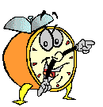
Let’s stop it here

Slide 49
Summary

Slide 50
The Communication Process
Encoding
Channel
Decoding
Message
Message
Source
Receiver
Feedback

Slide 51
Nonverbal Communication
Body Motions
Body Language
Facial Expressions
Tone of Voice
Paralinguistics
Pacing and Pitch

Slide 52
Barriers to Effective Communication

Slide 53
Directions of Communications

Slide 54
Next….

Slide 55
Organizational Behavior
(MGT-502)
Lecture-20

